Slide 1
DiPRIORI
Group members:
Yadynesh Desai 60003148003
Mrunal Medhekar 60003148004
Disha Mehta 60003148005
Guide: Mrs.Vinaya Sawant
Co- guide: Mr.Harshal Dalvi

Slide 2
Problem Definition
There is lot of shopping done by people online and offline.
These shopping marts have large set of transactions which can be used to find meaningful patterns.
Our application tells the shopkeeper where to place what, also about the discounts and combos.

Slide 3
Scope OF THE PROJECT
Application to be used by all online and offline shopping sites.
Generating useful knowledge and pattern in distributed manner.
Shows most frequently purchased item.
Scans and processes 100000 transactions or more within 60 secs.
Technologies: Python, Django.

Slide 4
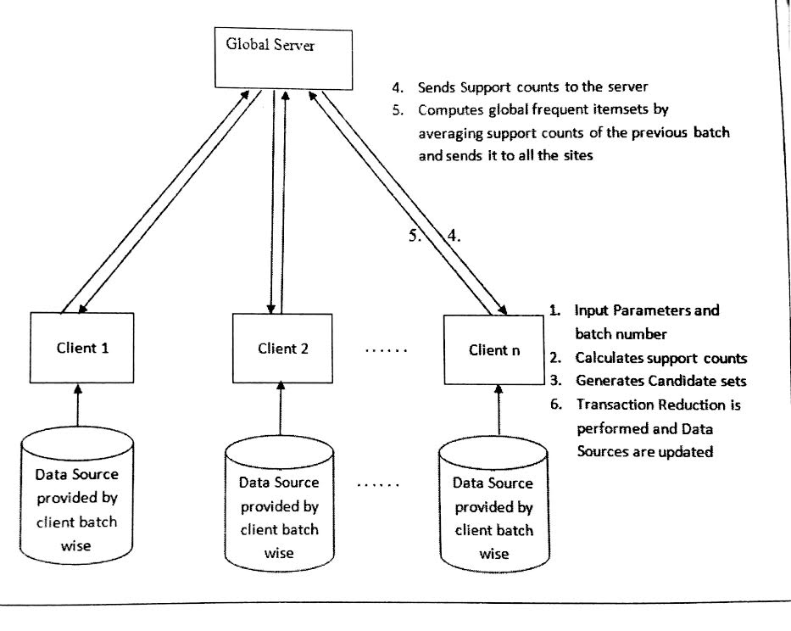
Existing system
Count Distribution Mining.
Fast Distribution Mining.
Optimized Distributed Association Rule Mining(ODAM).

Slide 5
Drawbacks of existing system
Large transactions cannot be processed.
Time consuming procedure.
Cannot process dynamic transactions.
Rules generated are not well presented for human analysis
Entire algorithm needs to be processed to analyse newly added transactions.

Slide 6
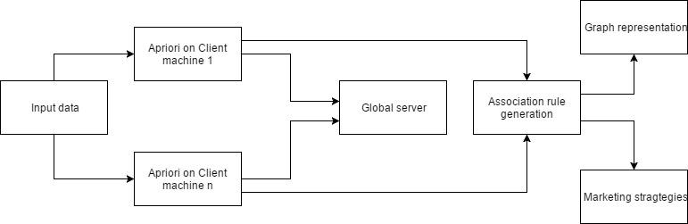
ARCHITECTURE OF Proposed System

Slide 7
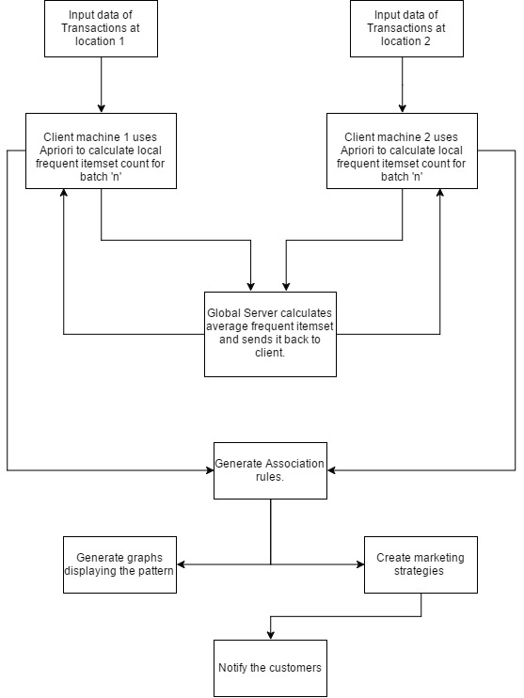
FLOW OF THE SYSTEM

Slide 8
Conclusion and FUTURE SCOPE
Proposed solution effectively analyses the data and gives meaningful results.
It also processes large number of transactions.
Analysis is done in distributed manner.
Converting this solution into full fledged e-commerce website by integrating with existing super market

Slide 9
Thank you

